Slide 1
James Webb Space Telescope
2022311224 이진진

Slide 2
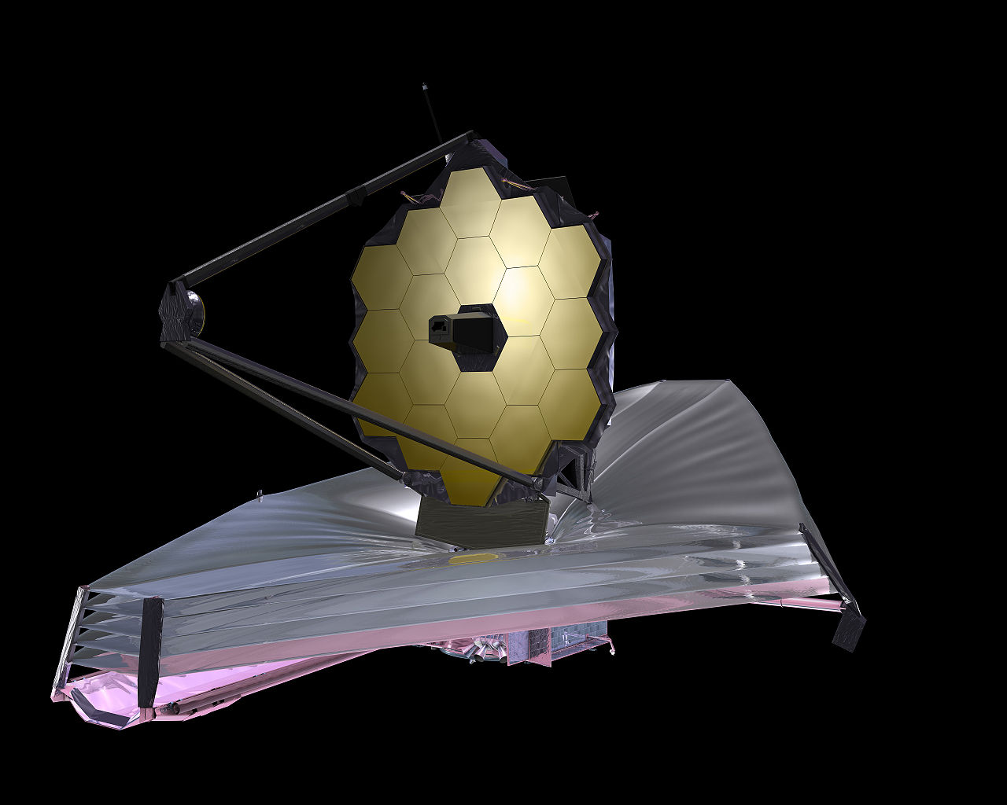

Slide 3
01
02
03
04
What is JWST?
Limitation of HST
instruments
Conclusion

Slide 4

01
What is JWST?
James Webb Space Telescope
Launch Date | 2021. 12. 25
Launch mass | 6161.4 kg
Dimensions | 20.197m x 14.162m
Power | 2 kW
Rocket | Ariane 5 ECA
Launch site | Centre Spatial Guyanais
Periapsis altitude | 250,000 km
Apoapsis altitude | 832,000 km
Period | 6 months
Main telescope | Diameter : 6.5 m
 | Focal ratio : 131.4 m
 | Wavelength : 0.6 – 28.3 μm

Slide 5
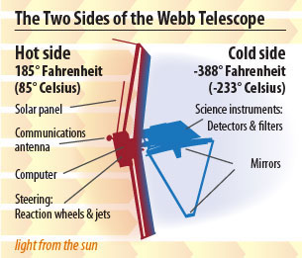
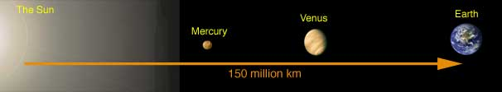
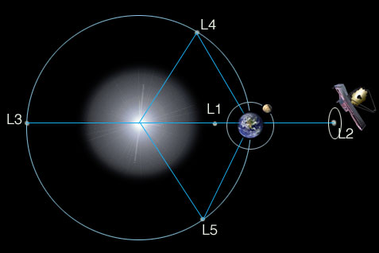
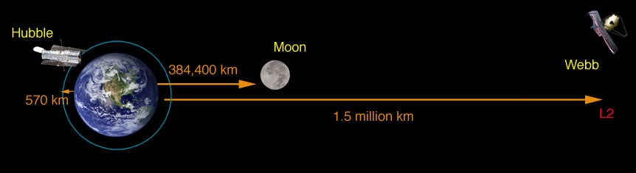
01
What is JWST?

Slide 6
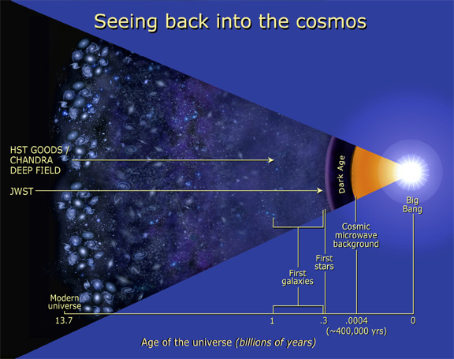
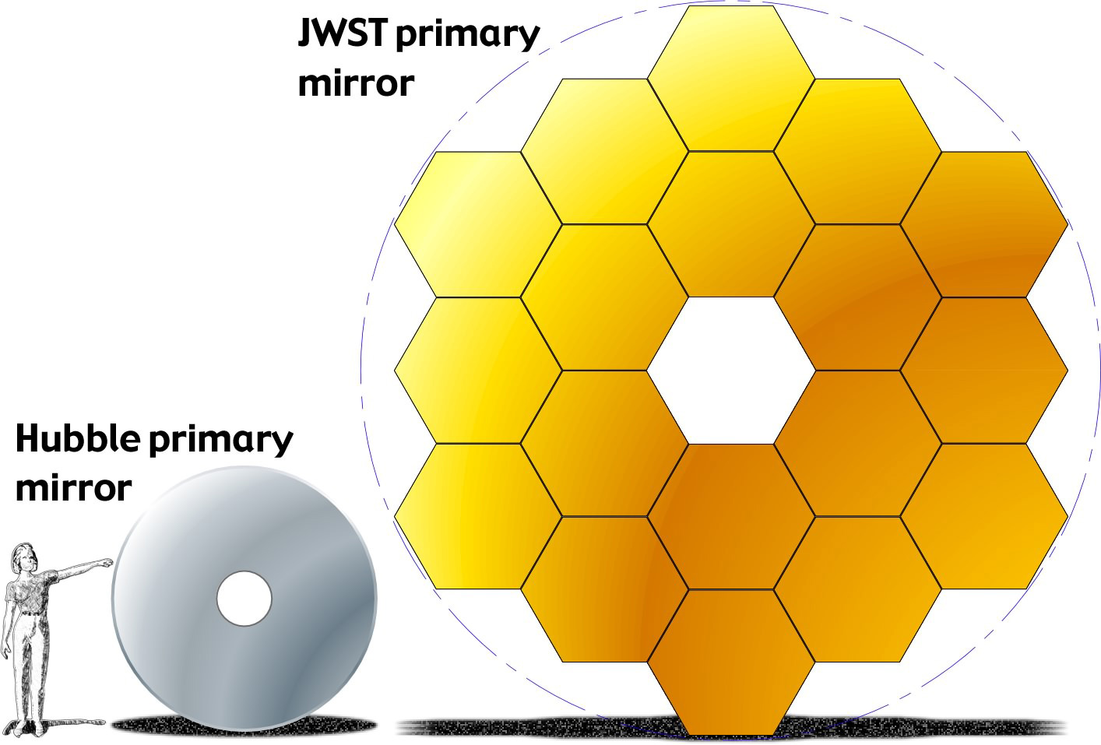
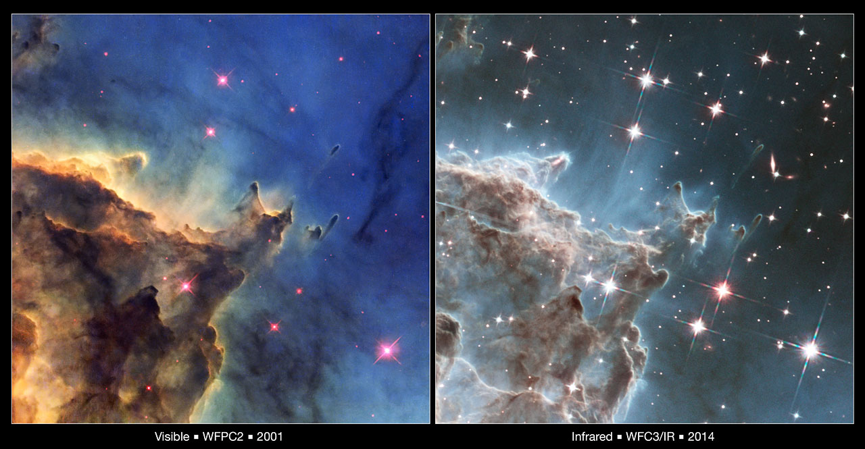
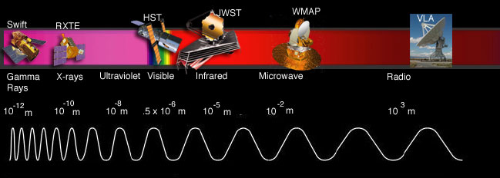
02
Limitation of HST
 | HST | JWST
wavelength | 0.8 ~ 2.5 μm (small portion of the IR) | 0.6 ~ 28 μm (primarily in the IR range)
Diameter of Primary Mirror | 2.4 m | 6.5 m
Orbit | Around the Earth | Around the Sun
Altitude | 570 km | 1.5 millions km (L2)
Period | 95.42 minutes | 6 months
Observation range | toddler galaxies | baby galaxies

Slide 7
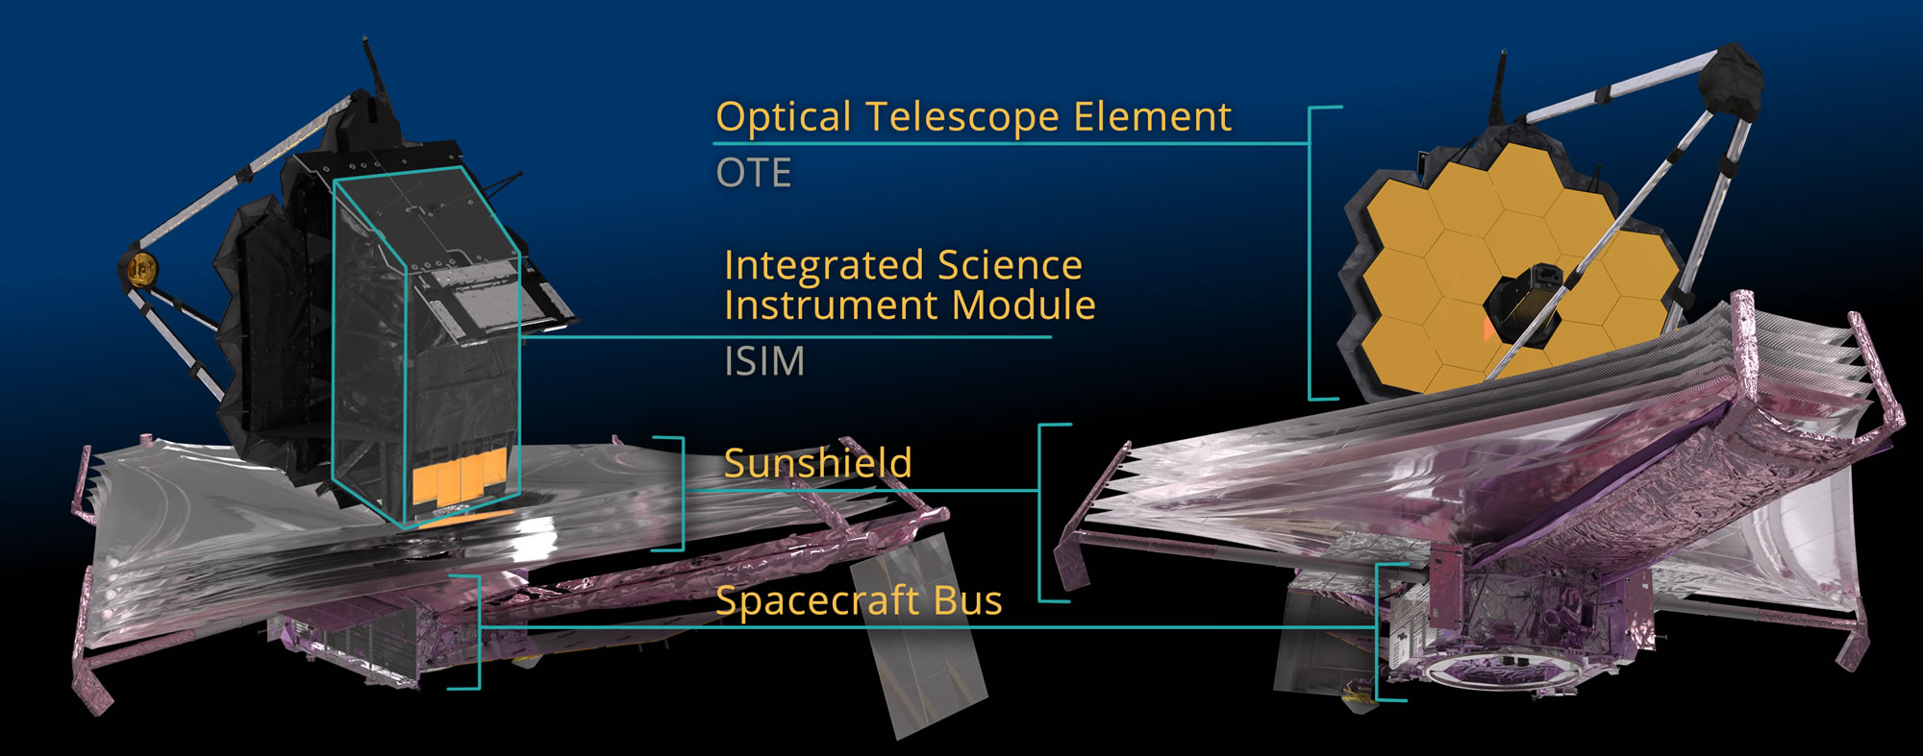
03
Instruments

Slide 8
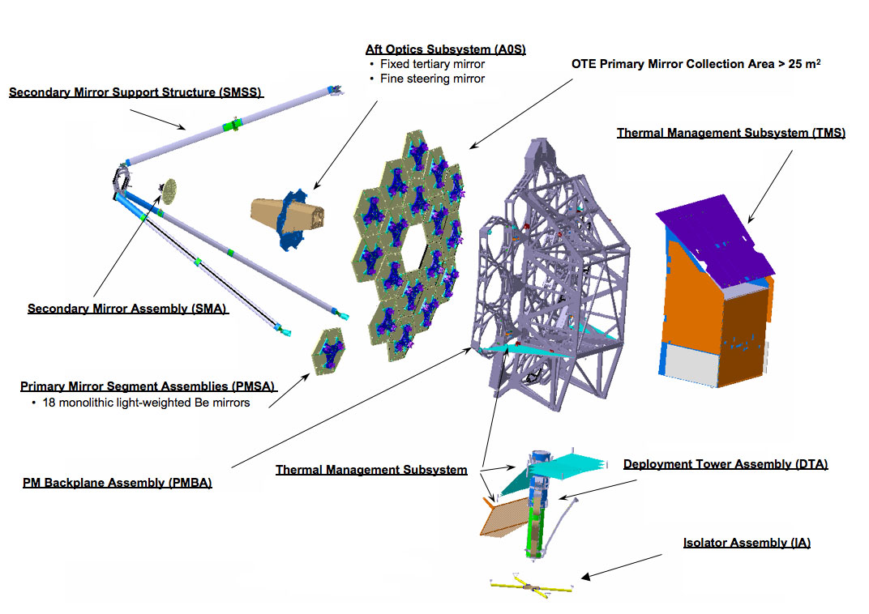
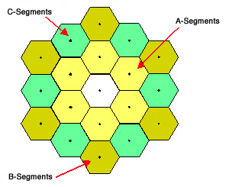
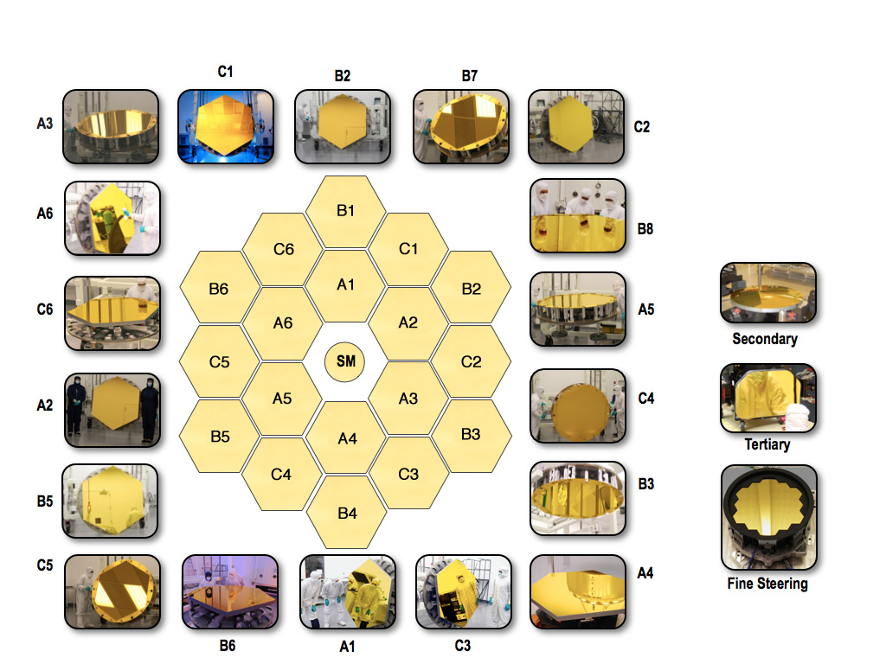
03
ㆍ 6.5m Primary mirror (18 hexa-segments)
Instruments - OTE
ㆍ 0.74m Secondary mirror
ㆍ Aft Optics Subsystem
(Tertiary mirror, fine steering mirror)
ㆍTelescope structure
- primary mirror backplane assembly
- the main backplane support fixture
- the secondary mirror support structure
- the deployable tower array
ㆍThermal Management Subsystem
ㆍAft Deployable ISIM Radiator
ㆍWavefront sensing and control

Slide 9
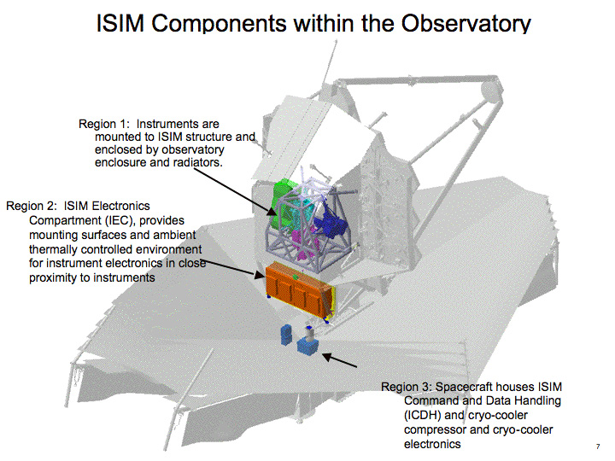
03
Instruments - ISIM
ㆍ Near-Infrared Camera (NIRCam)
ㆍ Near-Infrared Spectrograph (NIRSpec)
→ 0.6 – 5 μm
ㆍMid-infrared Instrument (MIRI)
→ 5 – 28.3 μm
ㆍFine-Guidance Sensor /
Near Infrared imager and Slitless Spectrograph
(FGS-NIRISS)
→ 0.8 – 5 μm

Slide 10
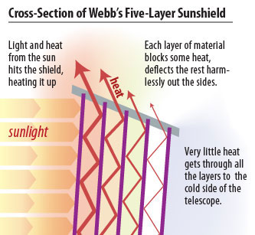
03
Instruments - Sunshield
ㆍseparates into a warm and a cold side
ㆍFive layers -> insulator

Slide 11
03
Instruments – Spacecraft Bus
ㆍElectrical Power Subsystem
ㆍ Attitude Control Subsystem
ㆍ Communication Subsystem
ㆍCommand and Data Handling
ㆍPropulsion System
ㆍRocket Thrusters And Propellant
ㆍThermal Control Subsystem

Slide 12
THANK YOU
FOR LISTENING

